Slide 1
The UMPIRE Strategy
TIP102
Week 1
Notes:
🌟 Purpose: Welcome students to the session, set the tone, and introduce the focus of the day.
✅ What should I be doing?
Greet students warmly and establish a positive atmosphere.
Remind students about the importance of staying engaged and participatory.
🎙️ What should I be saying?
Welcome to Week 1, Session 2 of TIP102! I’m so glad to have you here today.
Today, we’ll be exploring the UMPIRE strategy, a powerful framework for breaking down technical interview problems step by step. By the end of today’s session, you’ll feel confident applying it to your problem-solving process.
🙌🏽 How should I engage students?
Ask: "What’s one thing you’re looking forward to learning or practicing today? Drop it in the chat!"
Encourage students to unmute and share, or acknowledge responses in the chat to foster community.
Use humor or enthusiasm to set a friendly, engaging tone.

Slide 2
1 | Welcome 👋🏽 | 0:00 - 0:15
2 | The UMPIRE Strategy | 0:15 - 0:45
3 | BREAK | 0:45 - 0:50
4 | Collaborative Problem Solving | 0:50 - 1:50
5 | Wrap Up | 1:50 - 2:00
Notes:
🌟 Purpose: Provide a clear roadmap for the session and set expectations for timing and activities.
✅ What should I be doing?
Walk students through the agenda step-by-step.
Highlight key activities like the UMPIRE strategy introduction and collaborative problem solving.
🎙️ What should I be saying?
Here’s what we’ll be covering today: We’ll start with a quick introduction and warm-up activity to get ready for the session.
Next, we’ll spend about 30 minutes diving into the UMPIRE strategy—this is the core of today’s lesson and will give you a structured approach to tackling coding problems.
After a short 5-minute break, we’ll move into collaborative problem solving, where you’ll get hands-on practice with a partner or group.
Finally, we’ll wrap up with reflections and reminders for the week ahead.
Let me know if you have any questions about today’s schedule or activities!
🙌🏽 How should I engage students?
Ask: "Does anyone have specific questions about today’s plan or anything they’re particularly excited to work on?"
Encourage thumbs-up reactions or quick feedback in the chat to confirm understanding of the agenda.
Highlight the importance of the collaborative problem-solving section: "This is a great chance to apply what you’ve learned and get feedback from peers."

Slide 3
Welcome! 👋🏽
15 minutes

Slide 4

Turn on your cameras!
Notes:
🌟 Purpose: Encourage visual engagement for better interaction.
✅ What should I be doing?
Kindly ask students to enable their cameras.
🎙️ What should I be saying?
It’s great to see everyone! Turning on your cameras helps us stay connected and engaged.
🙌🏽 How should I engage students?
Use humor or compliments: "I know we’re all rocking the Zoom look today—let’s see those smiles!"

Slide 5

Announcements & Reminders
Don't Forget Cameras On!
You will be removed from today's session if you are not on camera and are unresponsive.
You will be unable to return to today's session if you are removed.
Notes:
🌟 Purpose: Stress the importance of being on camera to participate.
✅ What should I be doing?
Kindly remind students of the camera policy and address any concerns.
🎙️ What should I be saying?
To maintain engagement, please have your cameras on during the session. If you’re unresponsive, we may have to remove you from today’s class.
🙌🏽 How should I engage students?
Acknowledge challenges like technical issues and offer solutions (e.g., joining audio-only temporarily).

Slide 6
5 minutes
What is one goal you have this Summer?
Not accepted: get a job/internship 🫨
Let’s Create a Vision Board in Padlet!
https://padlet.com/allisonchan6/goal-showcase-1jc3zogo161qttz5

Slide 7
BREAK OUT ROOOOOMMM!!!!
Meeting new people
Python
Working on and solving problems
Unclear breakout room instructions
Repeat of orientation
UMPIRE was not explicitly introduced
More time in breakout room
Python
More TF presence
Notes:
🌟 Purpose: Share feedback from the previous session and highlight areas of success and improvement.
✅ What should I be doing?
Summarize feedback from the previous session's survey and present key takeaways.
🎙️ What should I be saying?
From your feedback, it seems many of you enjoyed [highlighted aspect]. One suggestion was [area for improvement]. We’ll work on that today.
🙌🏽 How should I engage students?
Ask: "Does anyone have additional feedback or suggestions?"

Slide 8

Choosing Your Breakout Room
We’ll share the link to the entry ticket so you can indicate what unit you are on.
We’ll create breakout groups based on the unit you selected.
When it’s Collaborative Problem Solving time, we’ll share the room assignments and demonstrate how to get to your room.
Notes:
🌟 Purpose: Prepare students for the breakout room process.
✅ What should I be doing?
Explain how breakout rooms are assigned and ensure everyone understands.
🎙️ What should I be saying?
We’ll use your entry tickets to assign breakout rooms based on your unit. Once your room is assigned, you’ll navigate there for collaborative problem-solving.
🙌🏽 How should I engage students?
Answer questions about breakout rooms and provide troubleshooting tips.

Slide 9

Traffic Lights
Periodically, I’ll ask you to enter your traffic light in the chat
GREEN — Keep going! YELLOW — Proceed Slowly RED — Stop!

Slide 10
The UMPIRE Strategy
30 minutes

Slide 11
UMPIRE
UNDERSTAND
IMPLEMENT
REVIEW
MATCH
PLAN
EVALUATE
Notes:
🌟 Purpose: Introduce the UMPIRE problem-solving framework.
✅ What should I be doing?
Define the UMPIRE strategy and explain how it structures technical problem-solving.
🎙️ What should I be saying?
UMPIRE stands for Understand, Match, Plan, Implement, Review, and Evaluate. It’s a step-by-step guide to approaching coding problems methodically.
🙌🏽 How should I engage students?
Ask: "Which of these steps do you think will be the most challenging for you?"

Slide 12
UMPIRE
UNDERSTAND
IMPLEMENT
REVIEW
MATCH
PLAN
EVALUATE
Notes:
🌟 Purpose: Narrow the focus to the first three UMPIRE steps.
✅ What should I be doing?
Highlight the importance of the Understand, Plan, and Implement steps.
🎙️ What should I be saying?
For now, we’ll focus on UPI: Understand, Plan, and Implement. Mastering these sets a strong foundation for solving problems.

Slide 13

Understand the Problem
Understand what the interviewer is asking with clarifying questions
Generate basic sample input and output
Explore more unusual edge cases
Explore tradeoffs (memory, performance, code simplicity)
Notes:
🌟 Purpose: Teach students how to break down and fully comprehend the problem statement.
✅ What should I be doing?
Guide students through asking clarifying questions and identifying sample inputs and outputs.
Encourage them to explore edge cases and constraints.
🎙️ What should I be saying?
The first step in solving any problem is to truly understand it. This means breaking it down into smaller parts and asking clarifying questions. For example, if the problem involves a list, you might ask: 'Can the list be empty?' or 'What happens if all the elements are the same?
Next, generate basic examples and edge cases. For instance, if the input is [1, 2, 3], what output should we expect? What about an empty list or one with negative numbers?
Finally, think about tradeoffs. Should our solution prioritize memory efficiency, speed, or simplicity?
🙌🏽 How should I engage students?
Ask: "Can someone share an edge case they’ve encountered in past coding problems?"

Slide 14

Plan the Solution
Describe your overall approach in one or two sentences
Write down the steps in English
Each step should be simple and clear
Notes:
🌟 Purpose: Help students organize their thoughts and create a clear roadmap before coding.
✅ What should I be doing?
Demonstrate how to outline a solution using step-by-step instructions in plain language.
Highlight the importance of simplicity and clarity in the plan.
🎙️ What should I be saying?
A good plan is like a map that guides your coding process. Start by describing your approach in one or two sentences. For instance, if we’re filtering numbers from a list, the plan might be: 'Loop through the list, check each element, and add valid elements to a new list.'
Break this down further into smaller, manageable steps. For example: Step 1, initialize an empty list. Step 2, iterate through the original list. Step 3, append elements greater than the threshold to the new list.
Remember, if your plan seems difficult to implement, it’s a sign you need to refine it.
🙌🏽 How should I engage students?
Prompt: "If we were planning a solution to reverse a string, what steps would you include?"
Encourage students to share their steps and discuss the clarity of their approaches.

Slide 15

Implement the Solution
Translate your plan into code.
A clear plan should be relatively easy to translate. If it’s hard to translate, the plan probably isn’t good enough.
Look up any basic Python that you need.
Notes:
🌟 Purpose: Guide students in translating a clear plan into Python code.
✅ What should I be doing?
Show how to implement the outlined plan while encouraging debugging and iteration.
Normalize challenges by discussing common mistakes.
🎙️ What should I be saying?
Now it’s time to bring our plan to life. Start coding step by step. If you encounter difficulties, revisit your plan—it might need adjustment.
It’s okay to look up syntax or refer to cheat sheets. Debugging and fixing errors are integral parts of programming. For example, if our code isn’t appending to the list as expected, we might add a print statement to see what’s happening in each iteration.
Writing clean, efficient code that aligns with your plan will make debugging and reviewing much easier.
🙌🏽 How should I engage students?
Ask: "What’s one way you debug your code when something goes wrong?"

Slide 16
Traffic Lights
GREEN — Keep going! YELLOW — Proceed Slowly RED — Stop!

Slide 17
20 minutes
Let’s see how we can use UPI to help us solve a problem.
Notes:
🌟 Purpose: Demonstrate problem-solving using UPI while normalizing challenges.
✅ What should I be doing?
Solve the given problem live using UPI. Highlight mistakes and demonstrate troubleshooting strategies.
🎙️ What should I be saying?
Let’s solve a problem together using UPI. First, we’ll understand the problem by clarifying inputs and outputs. Then, we’ll plan and finally implement our solution.

Slide 18
Problem 7: NaNaNa Batman!
Write a function nanana_batman() that accepts an integer x and prints the string "nanana batman!" where "na" is repeated x times. Do not use the * operator.
def nanana_batman(x):
pass
Input: x = 6
Output: "nananananana batman!"
Input: x = 0
Output: "batman!"
Notes:
🌟 Purpose: Demonstrate how to solve a problem using the UPI steps of the UMPIRE strategy (Understand, Plan, Implement), engaging students throughout and normalizing mistakes during implementation.
✅ What should I be doing?
Walk through the UPI steps of the UMPIRE strategy using a coding problem.
Encourage student participation by asking questions at each step.
Normalize mistakes by introducing a small error and debugging it collaboratively.
🎙️ What should I be saying?
1. Understand the Problem
"Let’s start with the first step: Understand. The problem asks us to [insert problem details, e.g., find the maximum sum of any subarray in a given array]."
"The input is [describe input], and the expected output is [describe output]. For example, if the input is [example input], the output should be [example output]."
"Let’s identify edge cases. For example, what happens if the array is empty? Or if all elements are negative?"
Ask: "Does everyone understand the problem requirements? Are there any questions?"
2. Plan
"Now let’s move to Plan. How can we break this problem into smaller steps?"
"For example, if we’re finding the maximum sum of a subarray, we could iterate through the array and calculate sums dynamically using a sliding window approach."
Write pseudocode: 1. Initialize variables to track the maximum sum and current sum.
2. Iterate through the array.
3. Update the current sum at each step, comparing it with the maximum sum.
4. Return the maximum sum.
"Does this plan make sense? Does anyone see potential challenges or optimizations we could make?"
3. Implement
"Let’s implement our plan step by step. I’ll start by defining the function and setting up the loop."
Code Example: def max_subarray_sum(arr):
max_sum = float('-inf')
current_sum = 0
for num in arr:
current_sum = max(num, current_sum + num)
max_sum = max(max_sum, current_sum)
return max_sum
"Notice how we update both current_sum and max_sum as we iterate through the array."
Normalize Mistakes: Introduce an intentional error, such as forgetting to initialize max_sum. Run the code and debug together:
"Hmm, it looks like we’re getting an error or incorrect output. Why do you think this is happening?"
"Let’s check our variable initialization. Ah, we forgot to set max_sum to a very small value initially. Let’s fix that and rerun the code."
🎙️ How should I engage students?
Ask: "What’s our next step after defining the variables? Why is this important?"
Prompt predictions: "Before running the code, what output do you expect for the input [1, -2, 3, 5, -1]?"
Encourage questions: "Does anyone see any potential issues with this approach? Let’s discuss!"
Celebrate contributions: "Great catch on the initialization error! Debugging is a key skill we’re building here."

Slide 19
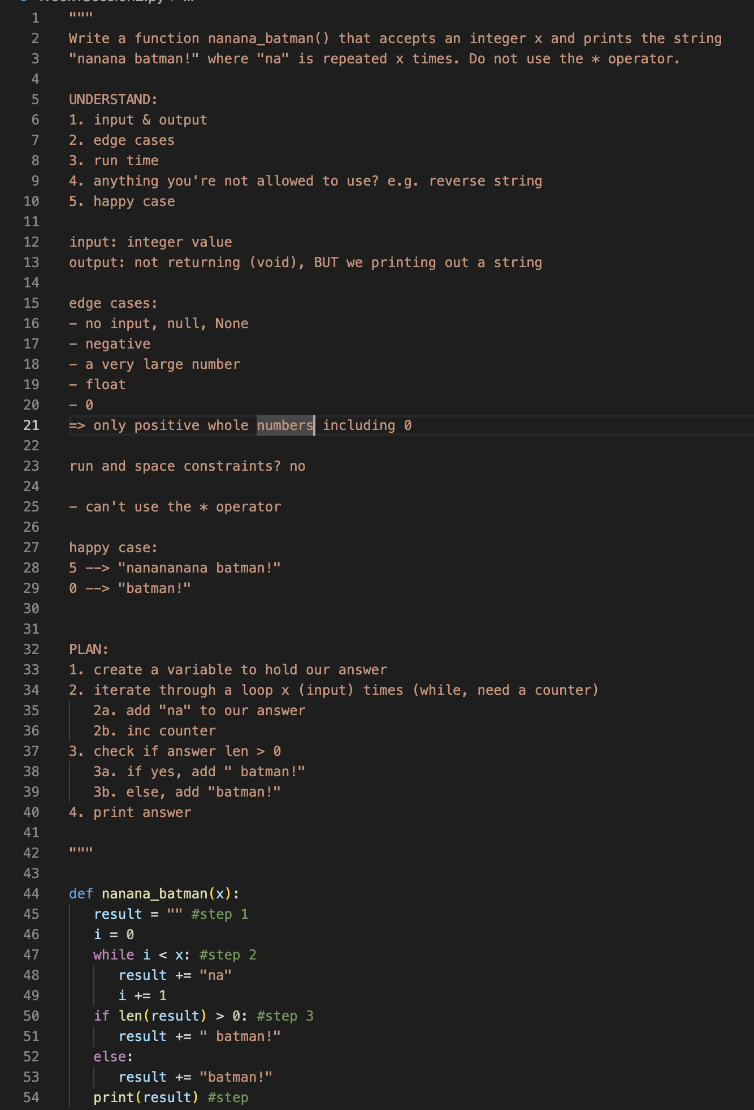

Slide 20
Traffic Lights
GREEN — Keep going! YELLOW — Proceed Slowly RED — Stop!

Slide 21

Break Time!
Take 5 mins to step away from the computer. Feel free to turn off your camera and return promptly after 5 mins.
Notes:
🌟 Purpose: Provide a short break to refresh and re-energize.
✅ What should I be doing?
Announce the break and remind students to return on time.
Play the countdown timer video (be sure to share sound).
🎙️ What should I be saying?
Let’s take 5 minutes to step away from the screen. Be sure to return promptly.

Slide 22
Collaborative Problem Solving
60 minutes

Slide 23
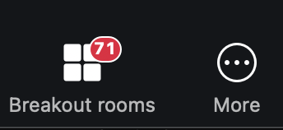
Choosing Your Breakout Room
We’ll share the room assignments.
We’ll demonstrate how to find your room assignment and navigate to your room.
Notes:
🌟 Purpose: Smoothly transition students into breakout rooms for collaboration.
✅ What should I be doing?
Share room assignments and explain how to join breakout rooms.
🎙️ What should I be saying?
Use the link to find your room and introduce yourself to your group.
🙌🏽 How should I engage students?
Check that everyone understands the process before sending them to breakout rooms.

Slide 24
50 minutes
🏃🏽 Navigate to your breakout room.
👋🏽 Introduce yourselves!
🧑🏽‍💻 Work on the problems for your selected unit.
Pair programming
Driver
Interview setting

Slide 25
Wrap Up
10 minutes

Slide 26
Notes:
🌟 Purpose: End the session on a positive note.
✅ What should I be doing?
Prompt students to share their reflections in the chat.
🎙️ What should I be saying?
Let’s celebrate your wins. Share one good thing you learned or accomplished today!
🙌🏽 How should I engage students?
Read a few responses aloud and celebrate with enthusiasm.

Slide 27


Session Survey Time!
Notes:
🌟 Purpose: Gather feedback to improve future sessions.
✅ What should I be doing?
Share the survey link and emphasize its importance.
🎙️ What should I be saying?
Your feedback helps us make these sessions even better. Please take a moment to complete the survey.
🙌🏽 How should I engage students?
Thank students for their input and explain how feedback has been used in the past.

Slide 28
UMPIRE
UNDERSTAND
IMPLEMENT
REVIEW
MATCH
PLAN
EVALUATE
Notes:
🌟 Purpose: Narrow the focus to the first three UMPIRE steps.
✅ What should I be doing?
Highlight the importance of the Understand, Plan, and Implement steps.
🎙️ What should I be saying?
For now, we’ll focus on UPI: Understand, Plan, and Implement. Mastering these sets a strong foundation for solving problems.

Slide 29
UMPIRE
The U-M-P section above should take 50-70% of your interview time !
These steps are the most crucial in having BOTH you AND the interviewer to be in agreement. It will show that you know how to approach a problem from all angles. Nothing should be assumed.
Many people skip directly to implementation step which shys away the opportunity to demonstrate problem solving skills. While writing code is important, HOW you think through the problem is what truly sets you apart.

Slide 30

Final Reminders
Finish the problem sets for additional practice
Take the weekly HackerRank assessment by Sunday @ midnight
Thank you for a GREAT first week :D
Notes:
🌟 Purpose: Reinforce key tasks and deadlines.
✅ What should I be doing?
Summarize next steps and encourage continued engagement.
🎙️ What should I be saying?
Don’t forget to complete the problem sets and take the HackerRank assessment by Sunday!
🙌🏽 How should I engage students?
Encourage students to ask any lingering questions before signing off.

